Slide 1

Lending Club Analysis Problem
Dinesh Chandrasekar, SAP
Jan 27th, 2022

Slide 2
Agenda
Understanding Dataset
Univariant analysis
Bivariant analysis
Multivariant analysis
Summary

Slide 3
Lending Club Dataset
The data contains the information about past loan applicants and whether they ‘defaulted’ or not.
The aim is to identify patterns which indicate if a person is likely to default, which may be used for taking actions such as denying the loan, reducing the amount of loan, lending (to risky applicants) at a higher interest rate, etc.

Slide 4
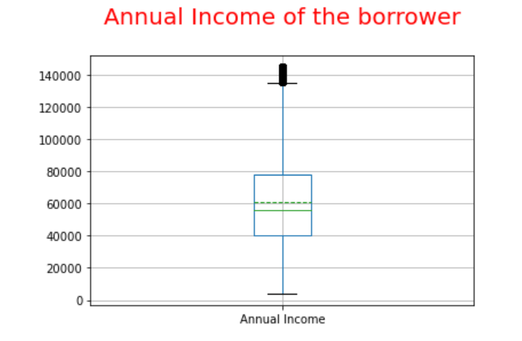
Univariant Analysis – Annual Salary
Most of the borrowers annual salary lies between 40000 and 78000

Slide 5
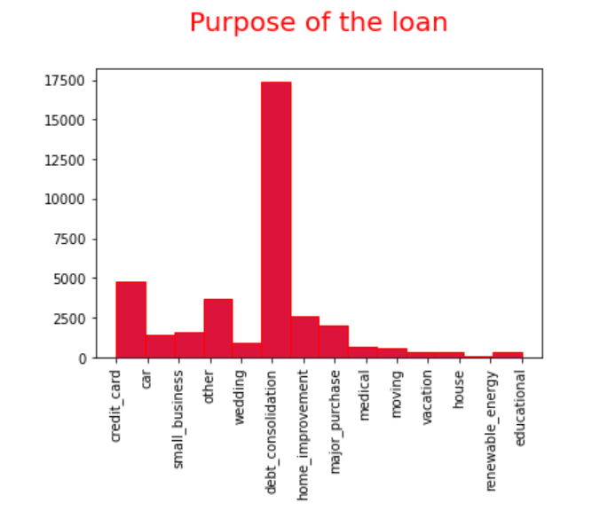
Univariant Analysis – Purpose of the Loan
Most of the borrower’s purpose of the loan is Debt consolidation

Slide 6
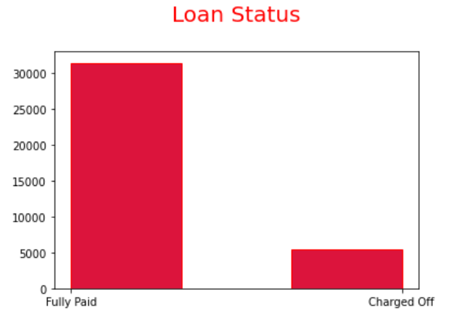
Univariant Analysis – Loan Status
Default ratio is 1:6 compared to the borrowers who paid off

Slide 7
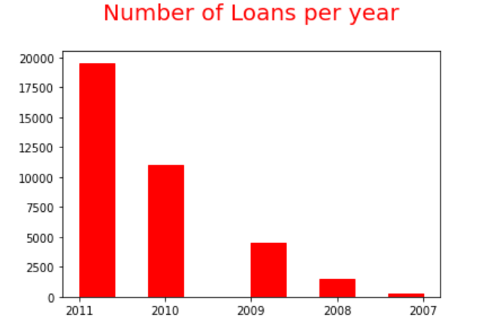
Univariant Analysis – Loans per year
Number of loans approved is steadily increasing each year since 2007

Slide 8
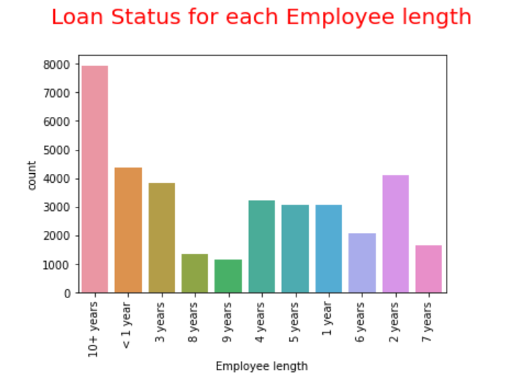
Univariant Analysis – Employee Length
People who have more than 10 years as experience are the most borrowers

Slide 9
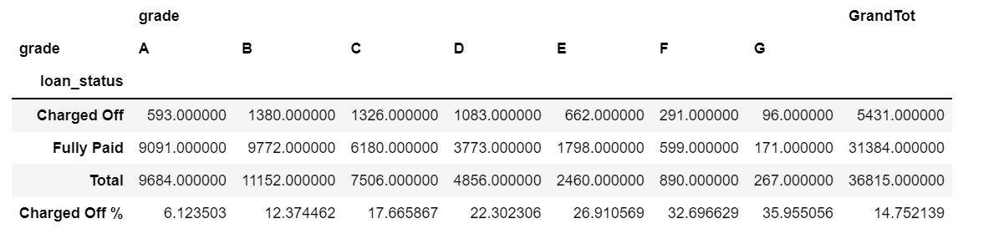
Bivariant Analysis – Grade on Loan status
As grade increases, default percentage increases

Slide 10
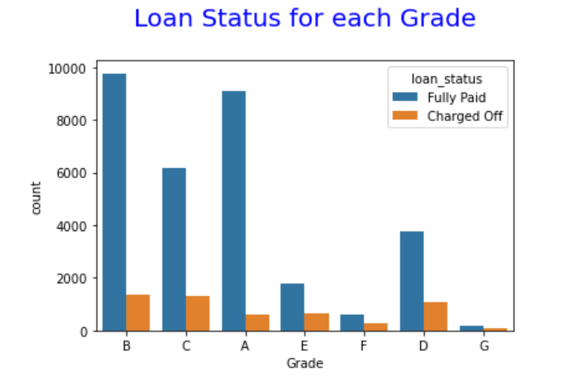
Bivariant Analysis – Grade on Loan status
As grade increases, default percentage increases

Slide 11
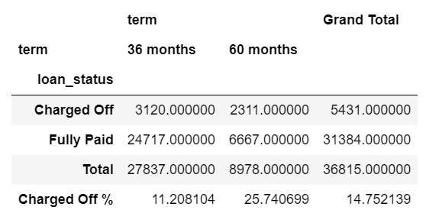
Bivariant Analysis – Term on Loan status
Loans with Term with 36 months are more likely to repay the loans

Slide 12
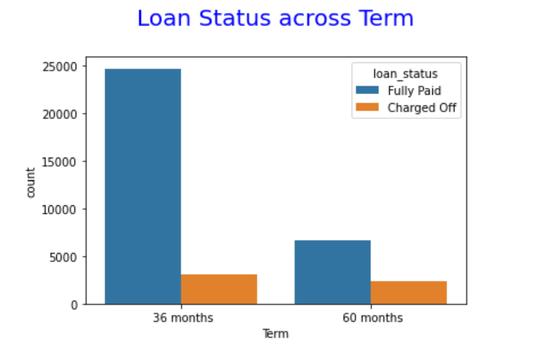
Bivariant Analysis – Term on Loan status
Loans with Term with 36 months are more likely to repay the loans

Slide 13
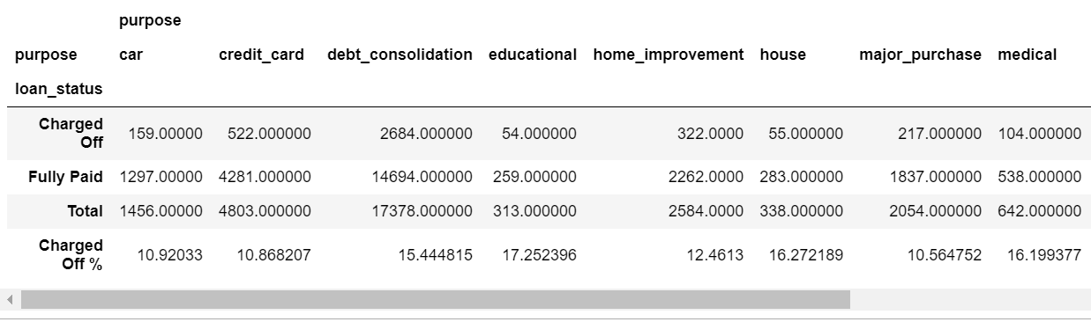
Bivariant Analysis – Purpose on Loan status
Business Loans are the high defaulters

Slide 14
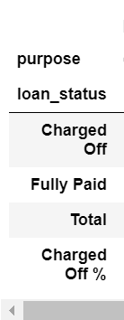
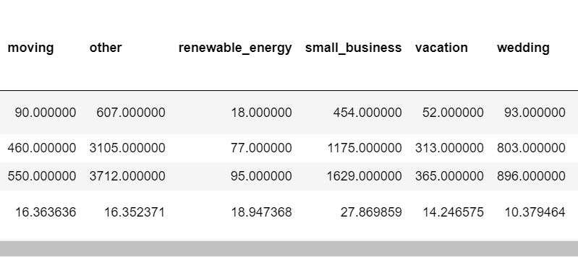
Bivariant Analysis – Purpose on Loan status
Business Loans are the high defaulters

Slide 15
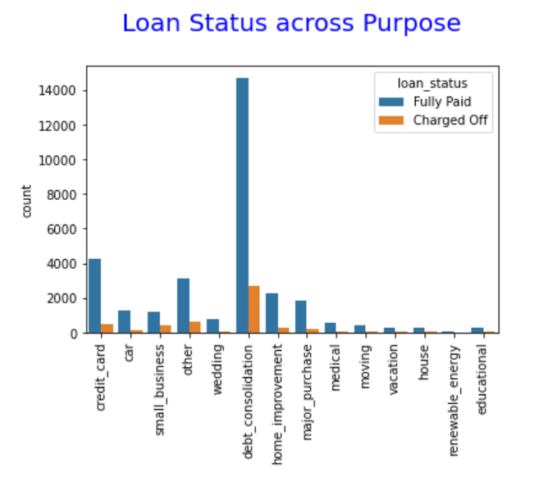
Bivariant Analysis – Purpose on Loan status
Business Loans are the high defaulters

Slide 16
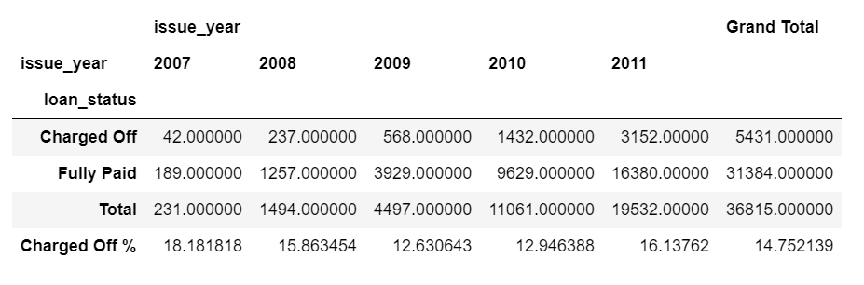
Bivariant Analysis – Issue Year on Loan status
Unable to predict based on year

Slide 17
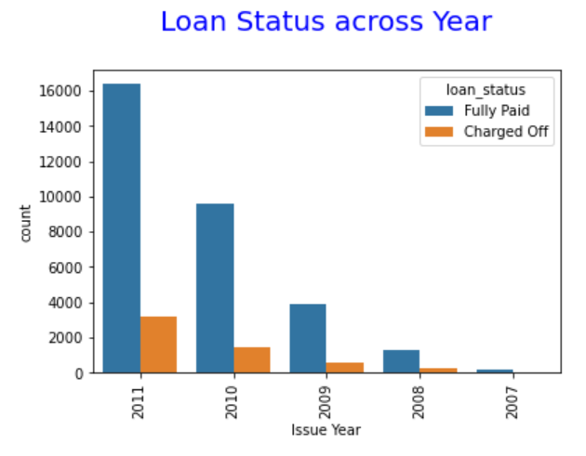
Bivariant Analysis – Issue Year on Loan status
Unable to predict based on year

Slide 18
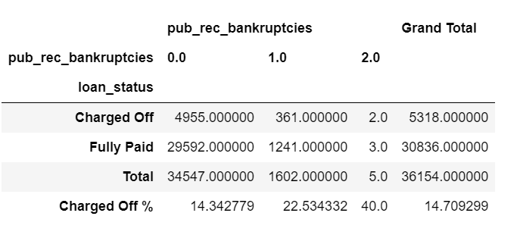
Bivariant Analysis – No of Bankruptcies on Loan status
Borrowers with 1 or more bankruptcies are having high chances of not paying back the loan

Slide 19
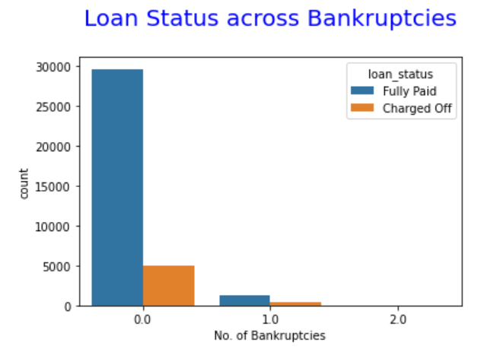
Bivariant Analysis – No of Bankruptcies on Loan status
Borrowers with 1 or more bankruptcies are having high chances of not paying back the loan

Slide 20
Multivariant Analysis
Multivariate Analysis on Loan amount, Interest rate and Loan status
Loans which has interest rate less 10 are more likely to be paid fully
Loans which has interest rate more than 10 have more possibility of default

Slide 21
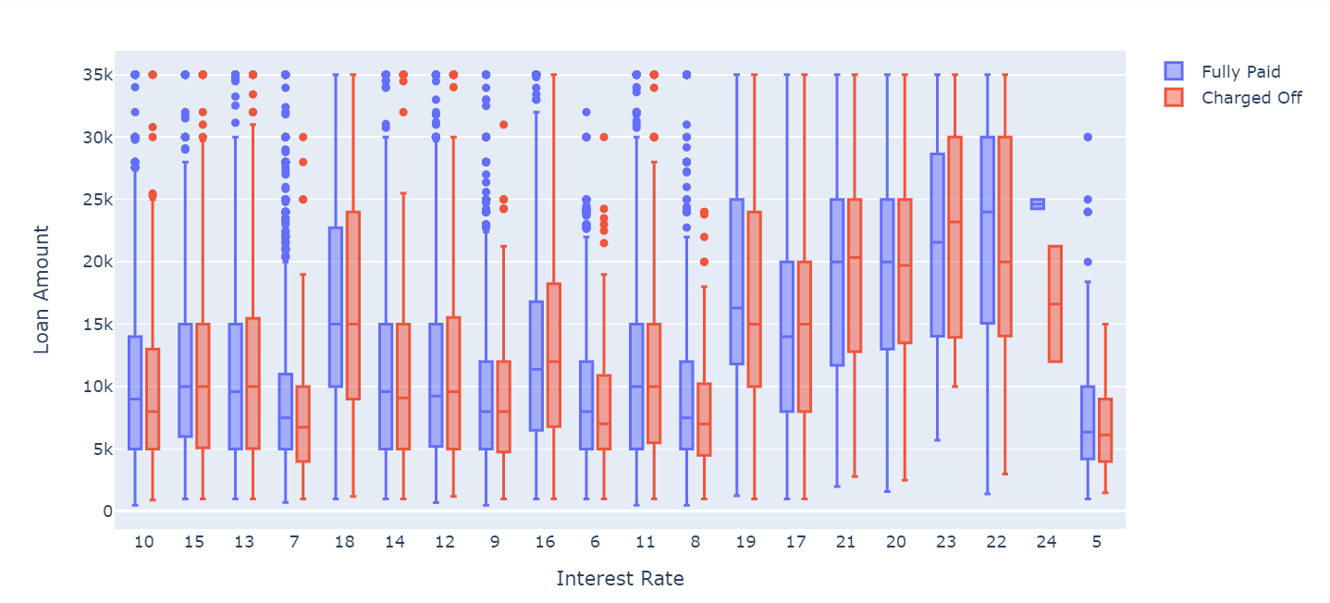
Multivariant Analysis

Slide 22
Summary
Higher the grade, higher chances of loan defaults
Loans with 60 months have more chances of loan defaults
Small business loans are more likely not to be paid back
Borrowers who has history of bankruptcies having high changes of default
Loans which has more interest rate are less likely to be collected back

